Slide 1
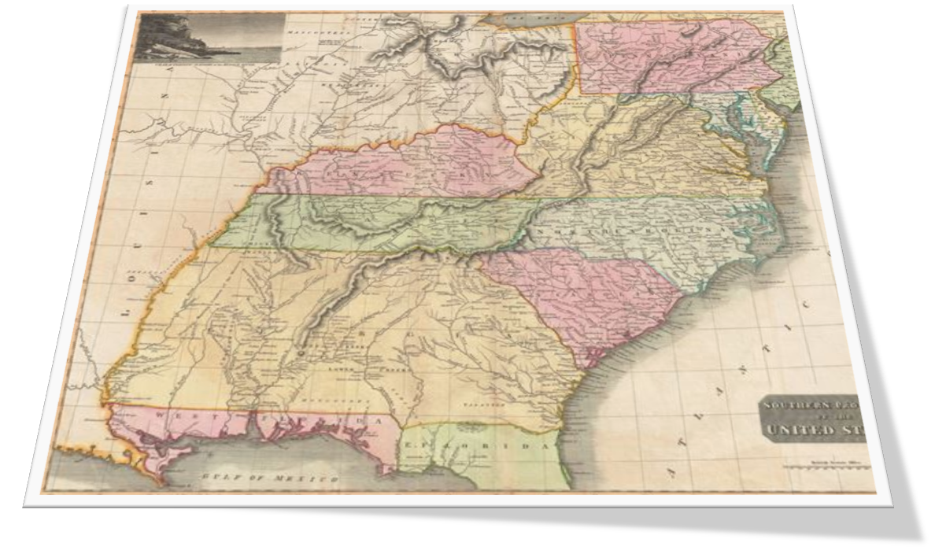
Paranormal Archaeology
Since 2008, I have conducted field-work at approximately 100 historic sites & properties throughout the mid-Atlantic & southern United States. Over time, a paranormal investigative model was developed based on research methodologies from anthropology, archaeology & history. During the last several years, I expanded my research to include the field of quantum physics in an effort to understand and explain the intelligent beings I regularly encounter. My work in this area is on-going and evolving as I continue to develop and hone my methodology.

Slide 2


Paranormal Archaeology: Uncovering History
Investigative sites are chosen on historic bearing, not on alleged haunting activity and evidence has shown that property with no reputed paranormal activity will yield results. I validate, correct and reveal the history of the sites I investigate.
Josiah Bell House: 1825
Q: What did you use this (attic) for?
EVP: For people.
Stony Landing House: 1839
Q: How did you get the Little David to Charleston?
EVP: Float, water, by boat
Josiah Bell House: 1825
Q: Is it (attic) for play or work?
EVP: Freedom
Wampee House: 1822
Q: Who’s the overseer?
EVP : Phillip. Phillip.
Stony Landing House: 1839
Q: We can’t figure out what they were used for (stone foundations) tell us. No one knows.
EVP: Help them. Help um. Piggies! Oink!

Slide 3
Timeline of Occupancy
As a first step, extensive historic research is done to identify the layers of occupation, oftentimes taking the site back to its earliest recorded habitation. Once the historic layers and their associated occupants are identified, a timeline of occupancy is established.
Hanover House: 1715 - Paul de St. Julien: Builder/Owner
Q:Who built this house?
EVP: Paul
Hanover House: 1715
Q:What year is it? EVP: November, 1811
Q: Talk to us Paul, what did you use this room for, we just want to know. (Master’s office)
EVP: For people. Eat. Sleep. Couch. Tobacco. Hospital.
Wampee House: 1822
Q: Are you in the Stewart family? EVP: Yes.
Q: Is that your last name, what’s your 1st name? EVP: Caleb
Say it so we can hear you
EVP: Caleb

Slide 4
Ethnographic Profile: Daily Life
John Manson House: 1825
Q: What kind of games do you play?
EVP: Pickle. (Colonial era game similar to dodge ball)
Hanover House: 1715
Q: What kind of games do you children play?
EVP: Chess.
John Manson House: 1825
Q: So do you have any animals?
EVP: Puppy yelp!
The Palace Saloon: 1903
What kind of card games?
EVP: Pepper. (Card game originating from Bid Euchre; circa 1860)

Slide 5
Ethnographic Profile: War
Wampee Plantation: 1696
EVP: Red Rider. Redcoat.
Moon River Brewing: 1733
EVP: Musket Fire and Canon
Hanover House: 1715
EVP: Step ‘em up! Salute! Halt!
Hanover House: 1715
Q: Who’s in the room, give us a name.
EVP: Murdoch, Lenny, Baker, McNichols, Neal.

Slide 6
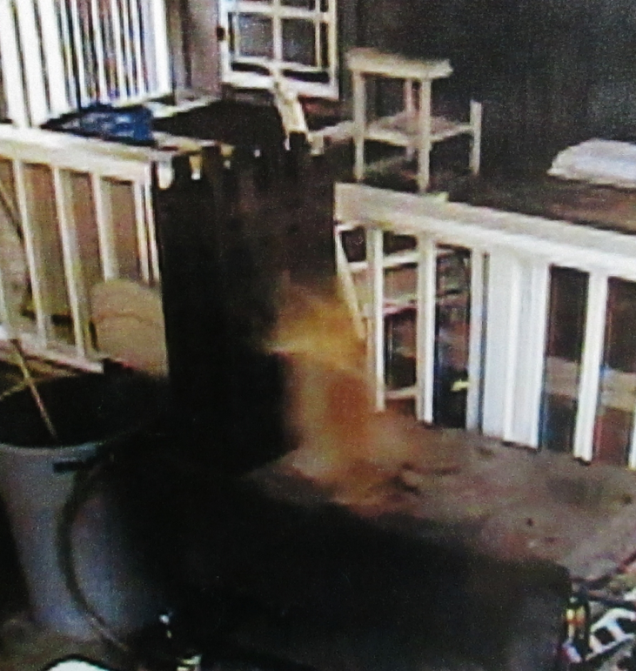
The Wampee Ghost Cat - Kittles
Wampee House: 1822
Q: Is this the room with the little girl?
EVP: Cat
Q: Can you tell us your name?
EVP : Sarah
EVP : Meow
EVP : Kittles. Meow. Pet her.

Slide 7
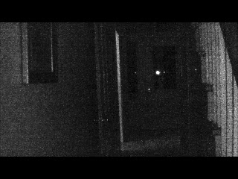
Stony Landing: Woman singing while house was unoccupied

